Slide 1
Practical Strategies to Maximize Engagement and Limit Disruption
EMPOWER Session 3
Presenters and Contributors | Contributors
Allison M. Bernard | Elise Sarasin
Mark M. Buckman | Rebecca L. Sherod
Kathleen Lynne Lane | Stacie Williams
Wendy Peia Oakes

Slide 3
Let’s Connect on Social Media!
Tag us in your Ci3T highlights- we’d love to see Ci3T in action!
Follow us on Twitter or Instagram for updates and links to resources!
@Ci3TModel

Slide 4
Ci3T Professional Learning Calendar
 | July | Aug | Sep | Oct | Nov | Dec | Jan | Feb | Mar | Apr | May | Jun
Ci3T Training |  |  |  |  | Ci3T Professional Learning Series Session 1 | Ci3T Professional Learning Series Session 2 | Ci3T Professional Learning Series Session 3 | Ci3T Professional Learning Series Session 4 |  | Ci3T Professional Learning Series Session 5 | Ci3T Professional Learning Series Session 6
Ci3T Implementation Support | Ci3T Implementation Series Prep Session |  | Ci3T Implementation Series Session 1 |  | Ci3T Implementation Series Session 2 |  | Ci3T Implementation Series Session 3 |  | Ci3T Implementation Series Session 4 | Ci3T Implementation Series Session 5
Ci3T EMPOWER |  |  | Ci3T EMPOWER Session 1 | Ci3T EMPOWER Session 2 | Ci3T EMPOWER Session 3 |  | Ci3T EMPOWER Session 4 |  | Ci3T EMPOWER Session 5 | Ci3T EMPOWER Session 6
Ci3T Trainers & Coaches Calls |  | Trainers & Coaches Call Session 1 | Trainers & Coaches Call Session 2 | Trainers & Coaches Call Session 3 | Trainers & Coaches Call Session 4 | Trainers & Coaches Call Session 5 | Trainers & Coaches Call Session 6 | Trainers & Coaches Call Session 7 | Trainers & Coaches Call Session 8 | Trainers & Coaches Call Session 9 | Trainers & Coaches Call Session 10

Slide 5
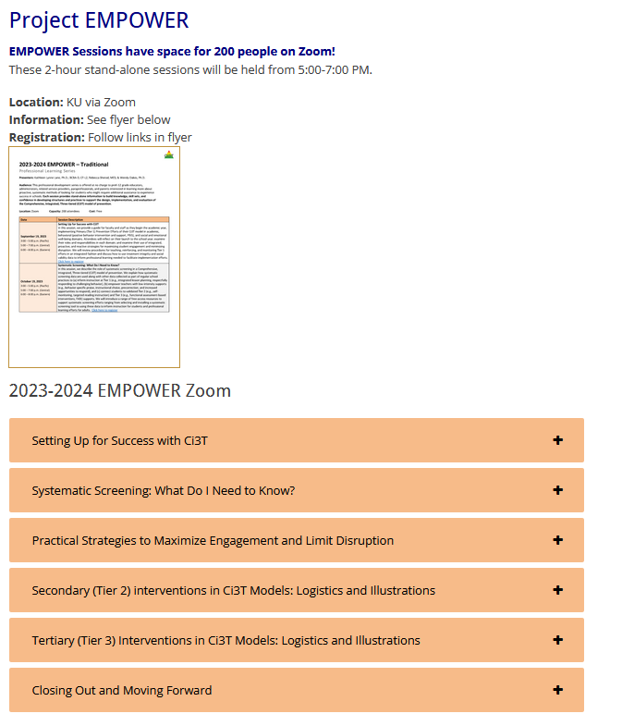
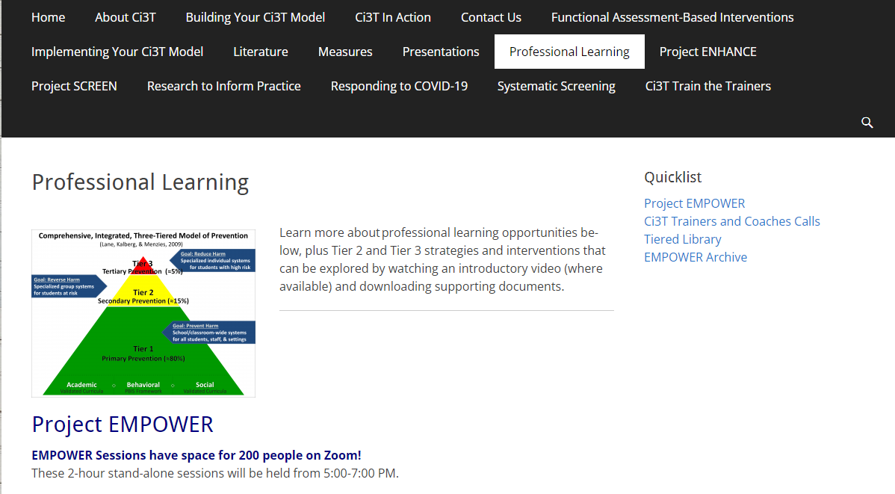
Accessing Project EMPOWER Professional Learning

Slide 6
Agenda
Welcome
Overview of Teacher-Delivered, Low-Intensity Strategies in Ci3T Models
Strategy 1: Precorrection
Strategy 2: Active Supervision
Strategy 3: Opportunities to Respond
Exploring Other Teacher-Delivered, Low-Intensity Strategies in Ci3T Models
Wrapping Up and Moving Forward

Slide 7
Welcome

Slide 8
The Journey of Ci3T: Respectful Partnerships
1997
Notes:
CA & AZ start→ Tennessee → North Carolina→ Kansas
Trainings (MO, KANSAS, VERMONT, AZ)
MO, KS, UAB
HI

Slide 10
Overview of Teacher-Delivered, Low-Intensity Strategies in Ci3T Models

Slide 11
Comprehensive, Integrated, Three-Tiered Model of Prevention
(Lane, Kalberg, & Menzies, 2009)
Tier 3
Tertiary Prevention (≈5%)
Tier 2
Secondary Prevention (≈15%)
Tier 1
Primary Prevention (≈80%)
Academic ◇ Behavioral ◇ Social
Validated Curricula PBIS Framework Validated Curricula

Slide 12
Ci3T Implementation Manual

Slide 13
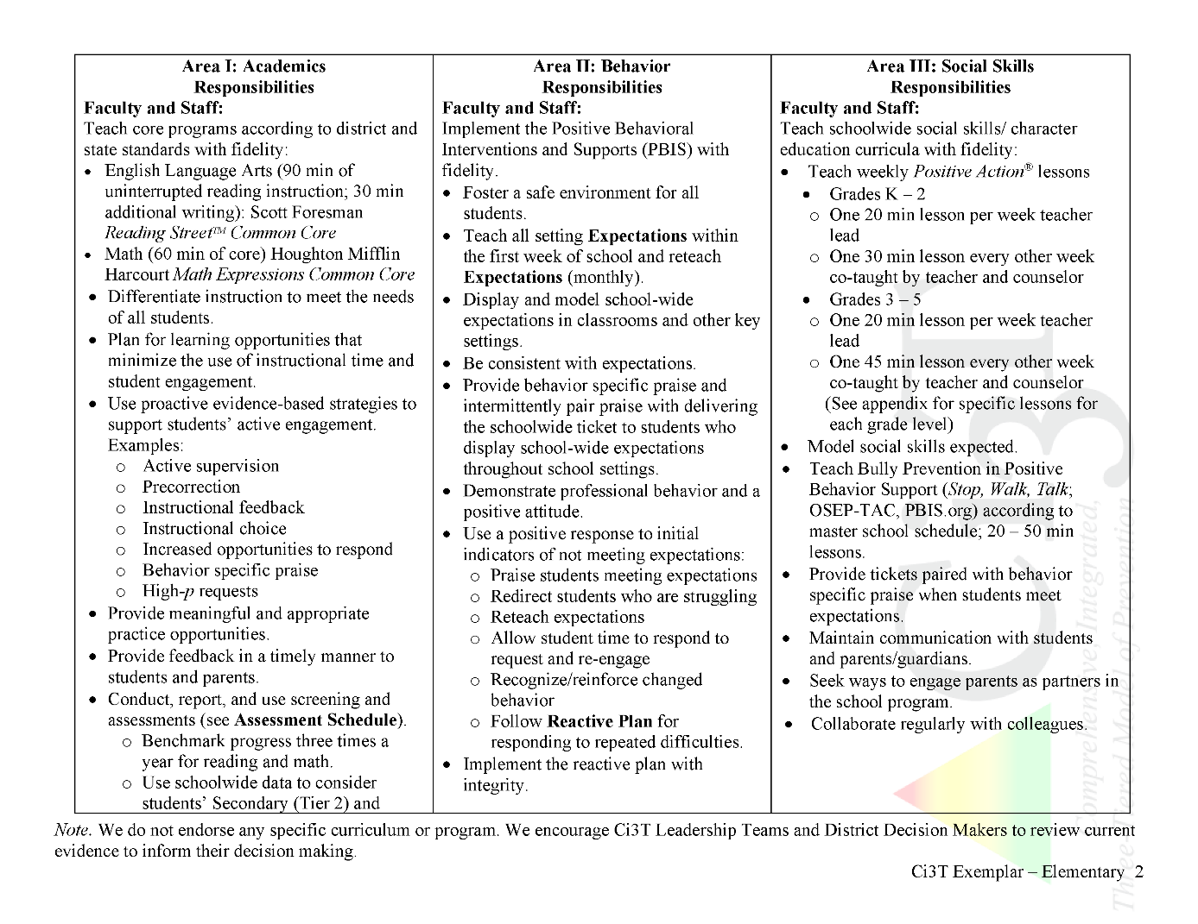
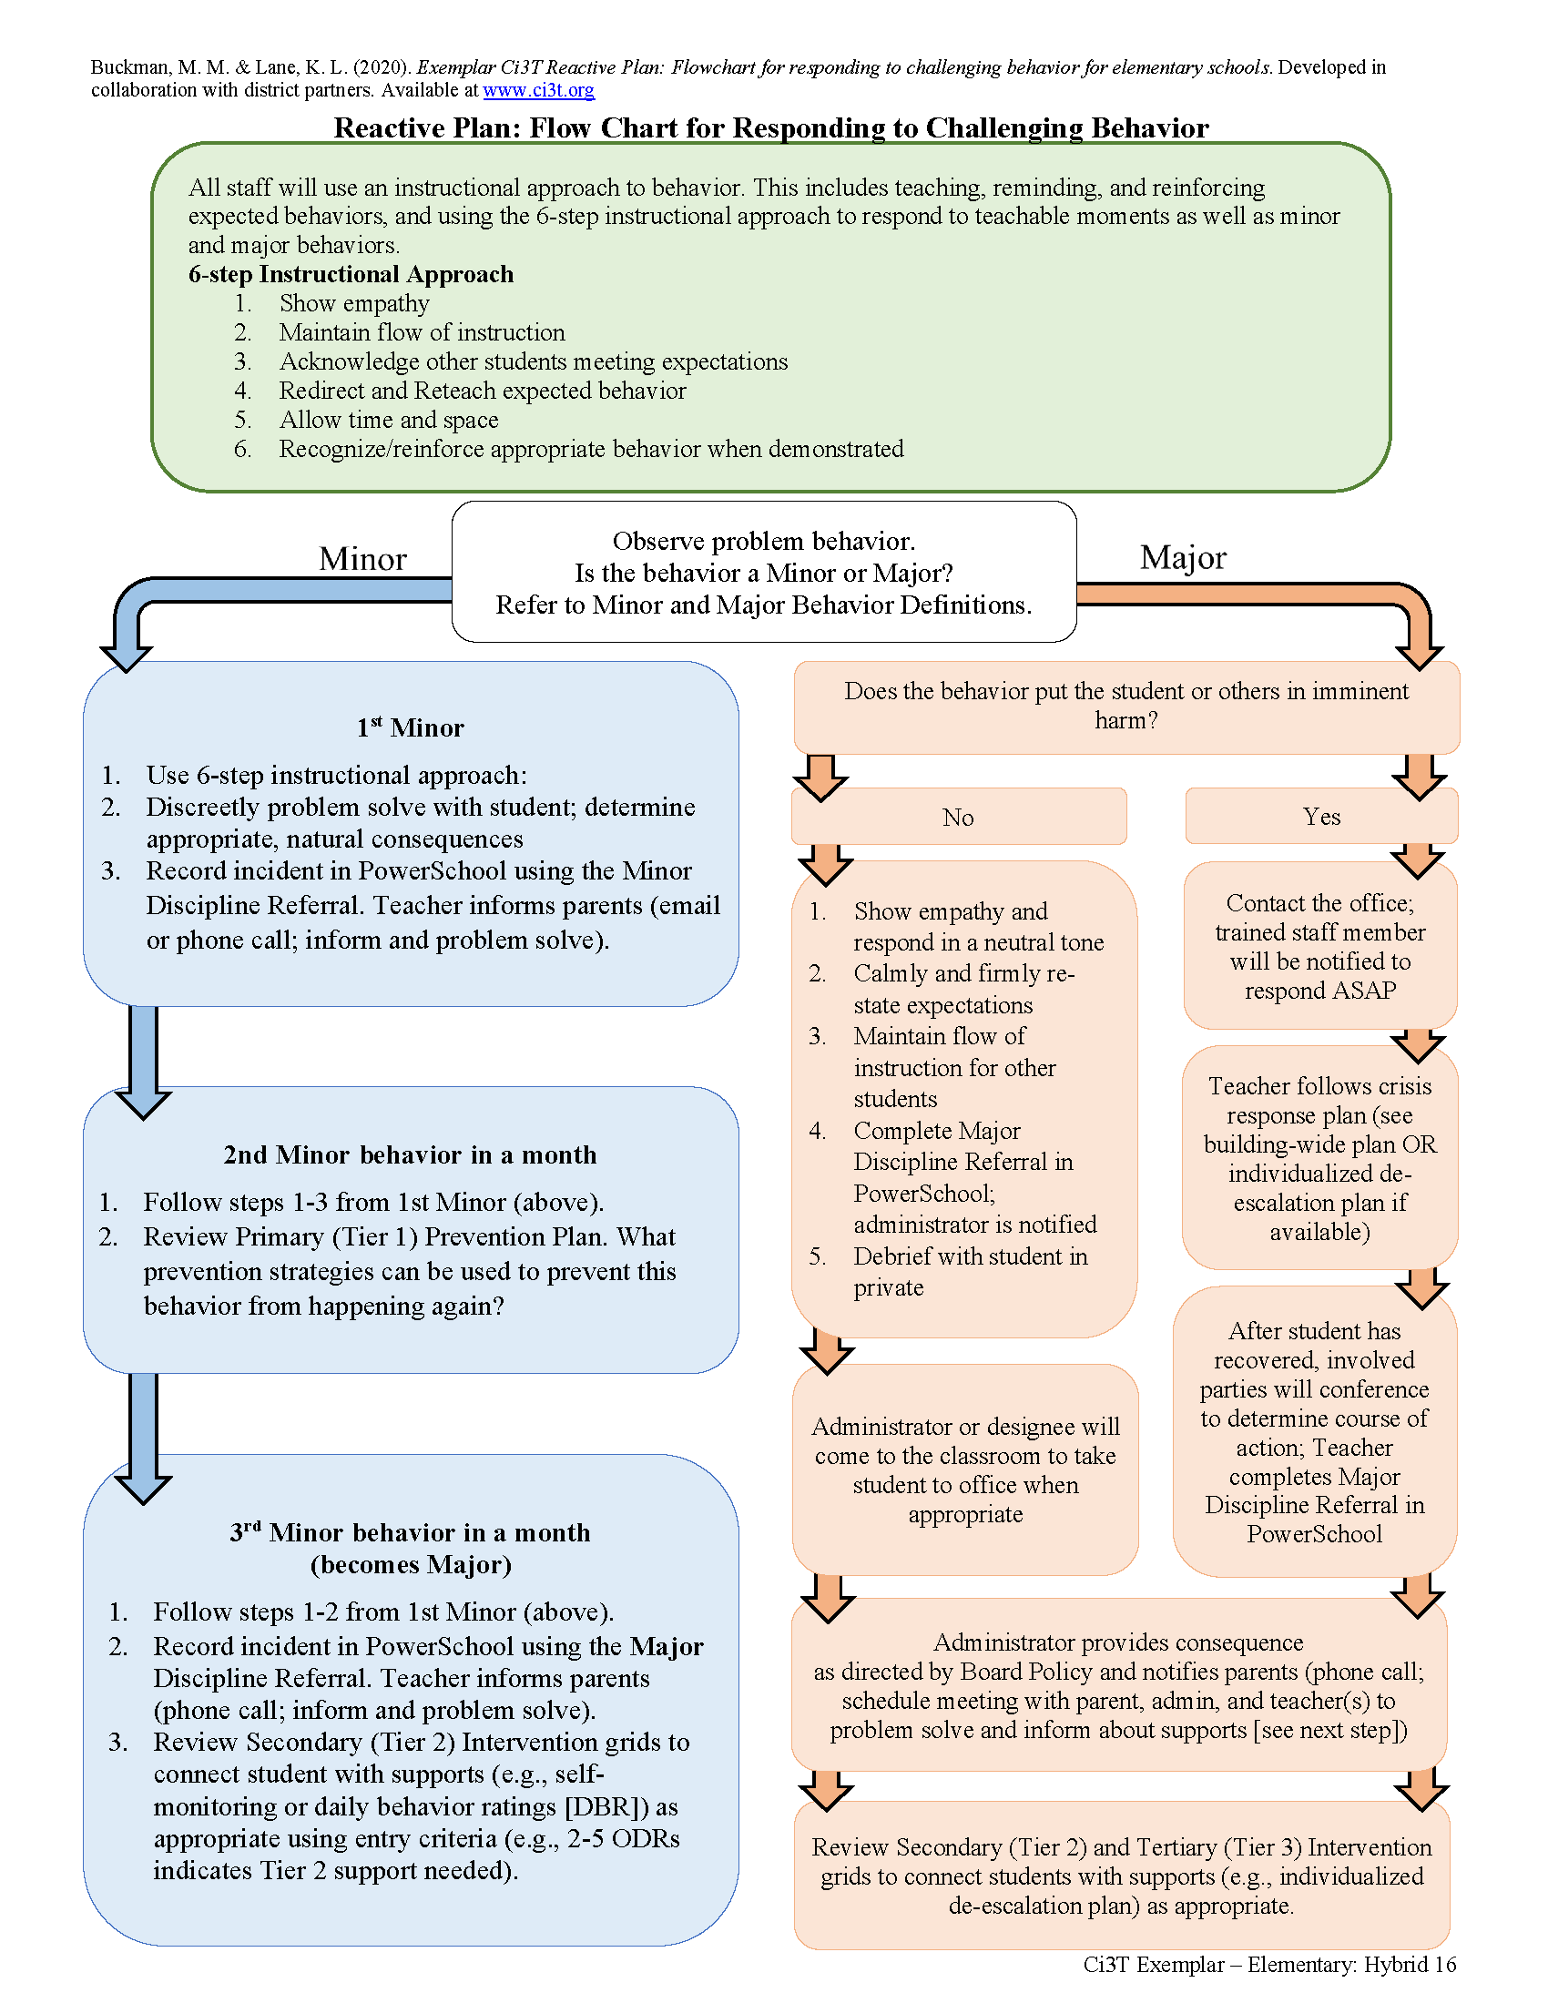
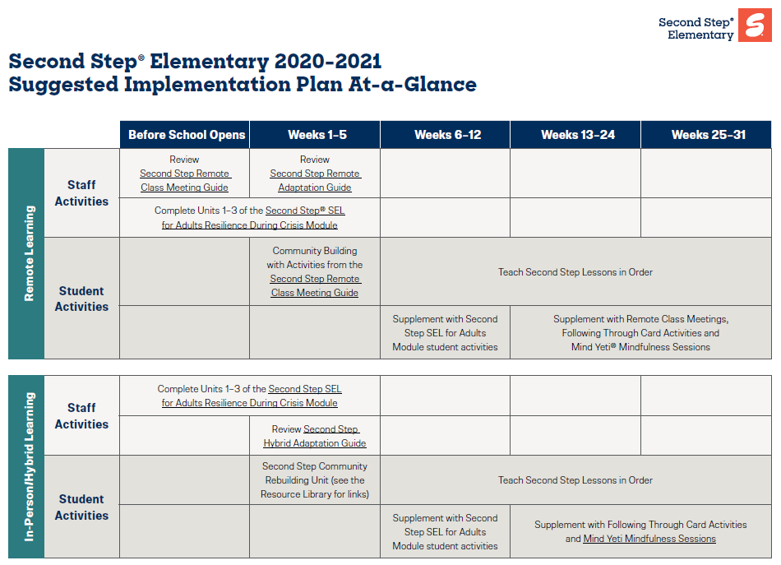
Ci3T Primary Plan: Procedures for Teaching
Opportunities to Respond
Behavior-Specific Praise
Ci3T Primary Plan: Procedures for Reinforcing
Active Supervision
Instructional Feedback
High-p Requests
Ci3T Primary Plan: Procedures for Monitoring
Precorrection
Instructional Choice
Notes:
Continued to keep implementation manuals, which are foundational to Ci3T, updated and current

Slide 14
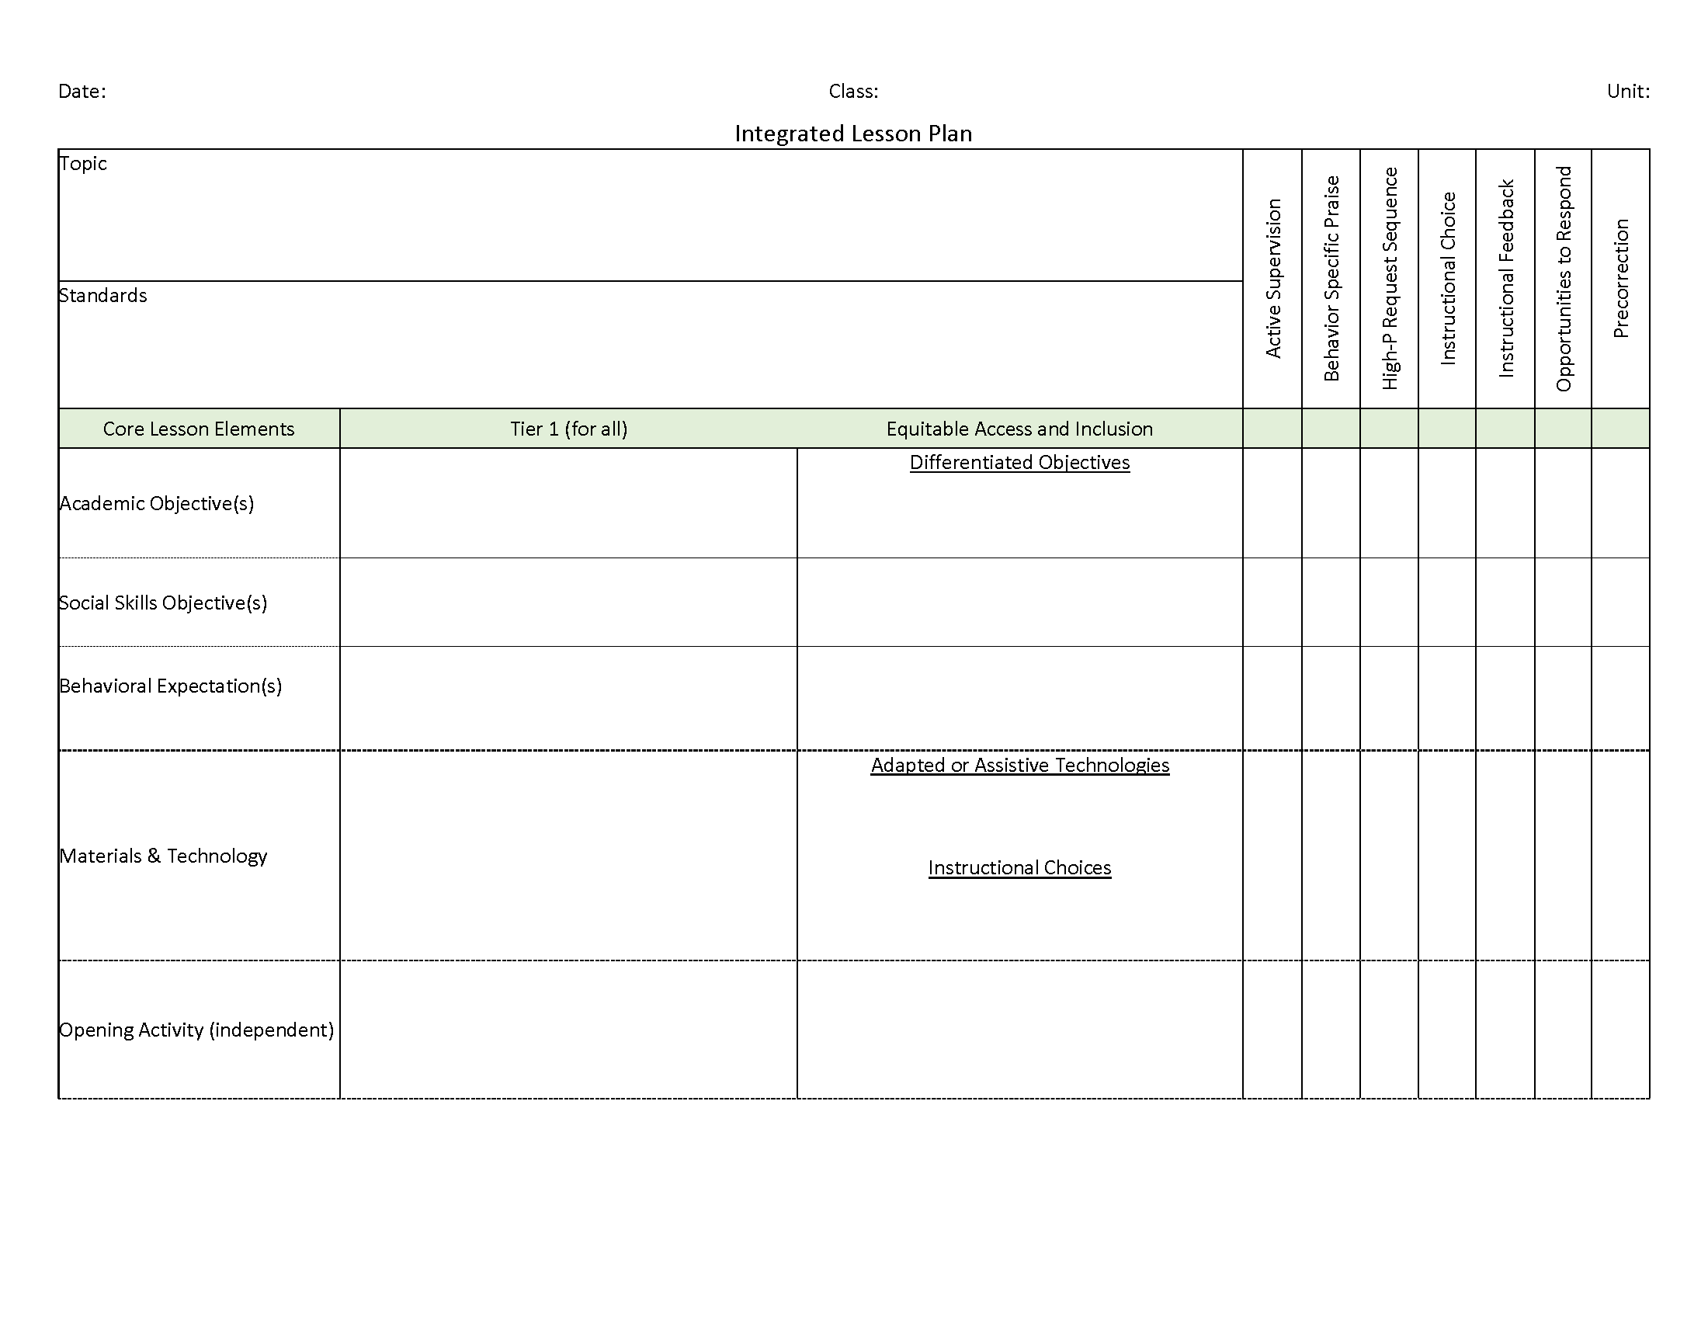
Ci3T: Integrated Lesson Planning
Integrated lesson planning is a core feature of Ci3T. Please visit https://www.ci3t.org/covid to learn more!

Slide 15
Essential Components of Primary Prevention Efforts
Social Validity
Systematic Screening
Academic
Behavior
Treatment Integrity
ci3t.org/measures
Notes:
Infographic - https://www.ci3t.org/measures

Slide 18
Building a Ci3T Tier Library
Teacher Delivered Strategies
Tier 1
Tier 2
Tier 3

Slide 19
Opportunities to Respond
Behavior-Specific Praise
Active Supervision
Instructional Feedback
High-p Requests
Precorrection
Instructional Choice

Slide 20
Consider Teacher-Delivered Strategies Across Tiers
Opportunites to Respond
Behavior-Specific Praise
Active Supervision
Instructional Feedback
High-Probability Requests
Precorrection
Instructional Choice

Slide 21
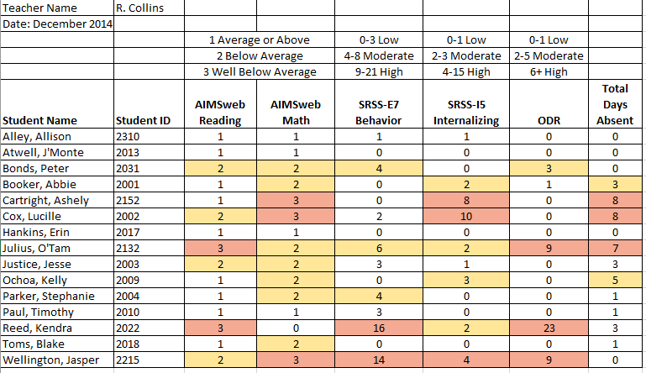
Examining Academic and Behavioral Data
Lane, K. L., Menzies, H. M., Ennis, R. P., & Oakes, W. P. (2015). Supporting Behavior for School Success: A Step-by-Step Guide to Key Strategies. Guilford Press.
Notes:
Lane, K. L., Oakes, W. P., Ennis, R. P., & Hirsch, S. E. (2014). Identifying students for secondary and tertiary prevention efforts: How do we determine which students have Tier 2 and Tier 3 needs? Preventing School Failure, 58, 171-182, DOI: 10.1080/1045988X.2014.895573

Slide 22
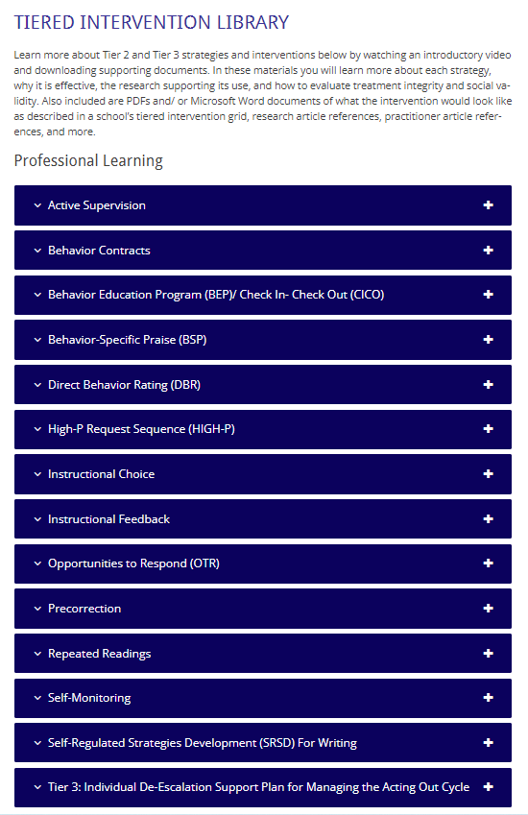
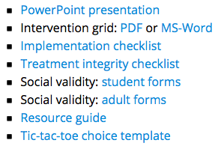
Low Intensity Strategies
https://www.ci3t.org/pl

Slide 23
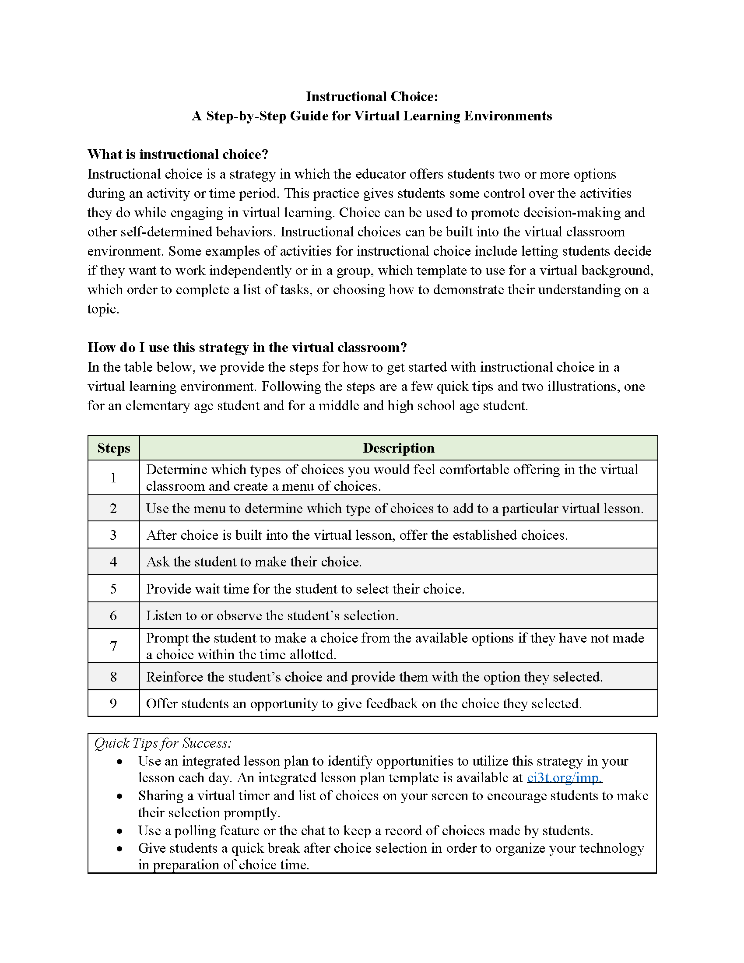
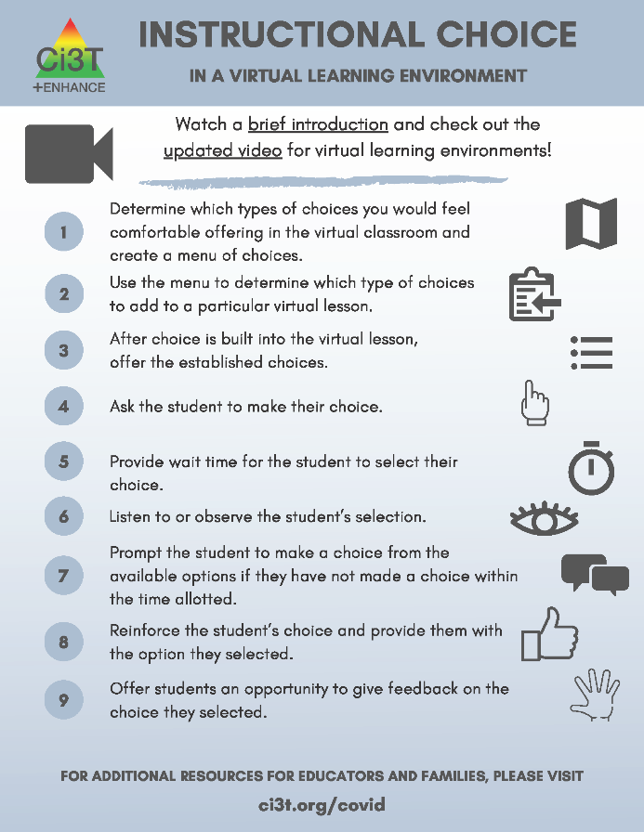
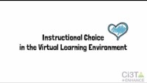
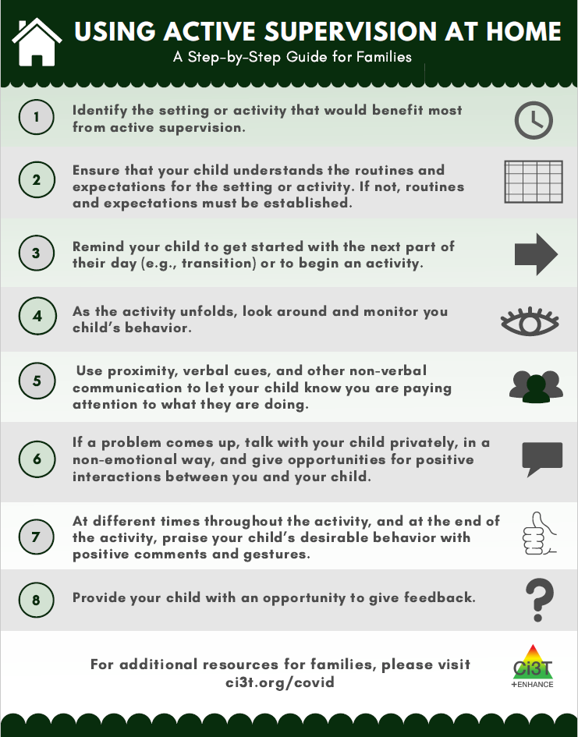
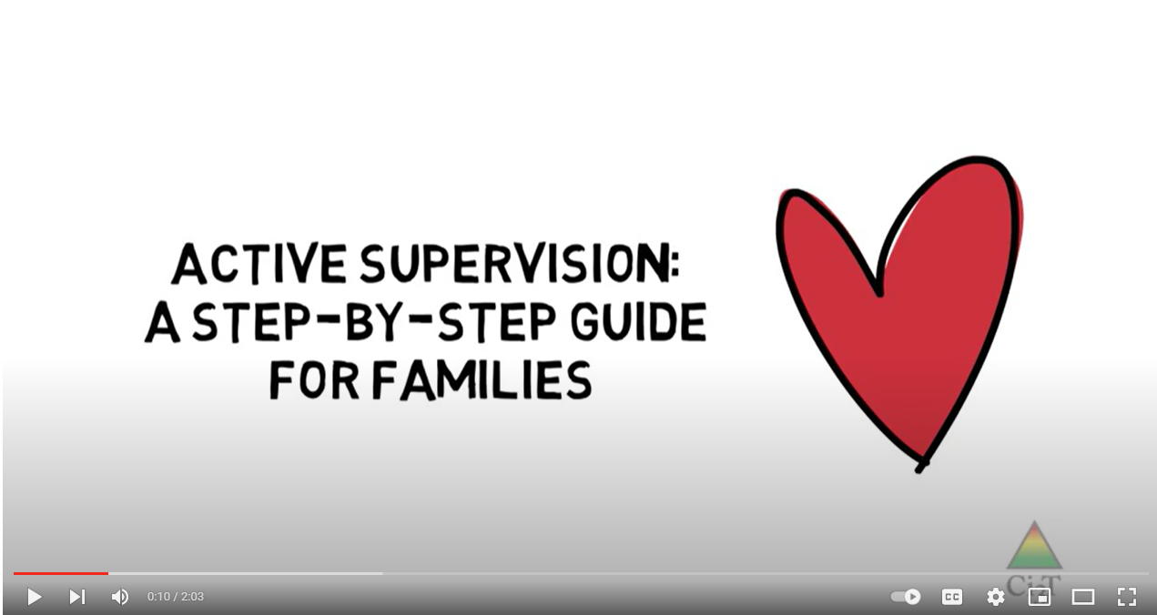
Low Intensity Strategies
https://www.ci3t.org/covid

Slide 24
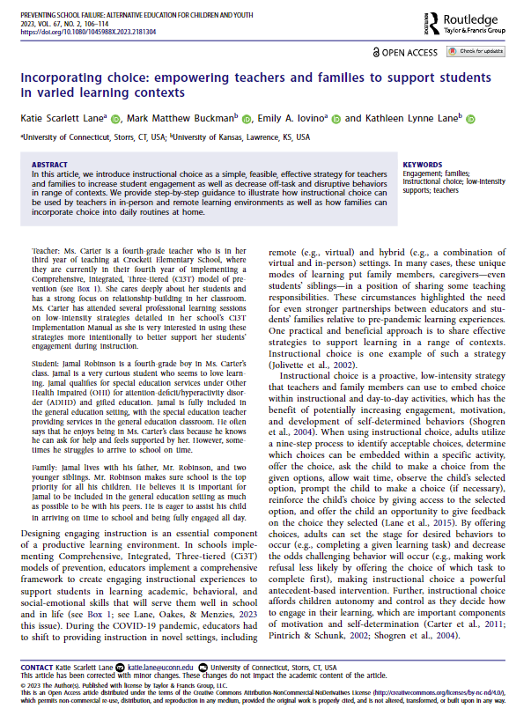
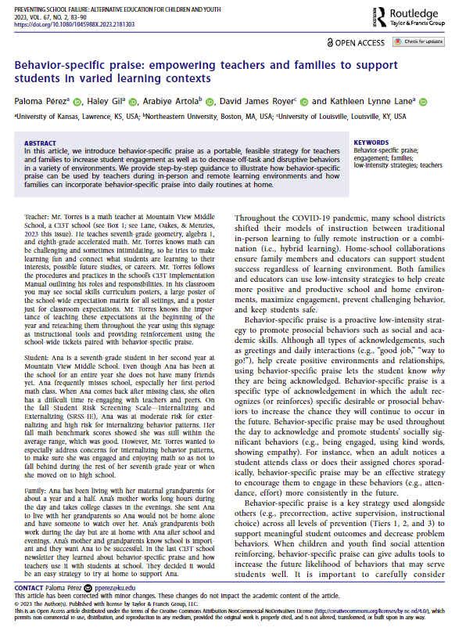
Low Intensity Strategies
https://www.ci3t.org/literature

Slide 25
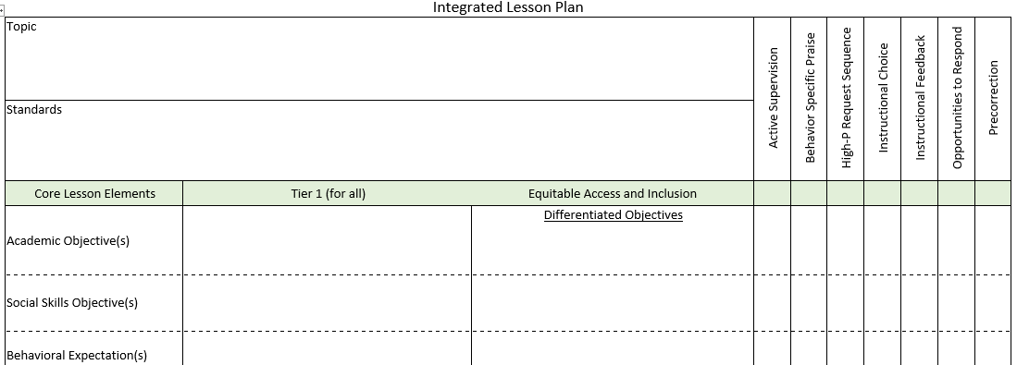
Integrated Lesson Planning

Slide 26
Low-Intensity Strategy | Franklin High School On-Site Expert
Behavior-Specific Praise: Identifying the specific expectation the student met. “Niama, I noticed you outlined your paper and used the graphic organizer to draft your essay. Well done!” “Justice, thank you for pushing in your chair to keep the walkway safe.” | Eric Common, Behavior Specialist Mark Buckman, Special Education Grant Allen, Parent Volunteer Paloma Pérez-Clark, School Psychologist
Opportunities to Respond: Providing 4-6 opportunities per minute for students to respond individually, choral, verbal, written, gesture, or symbol. “Show me thumbs or thumbs down if...” “Show me on your white board what…” “Turn to your elbow partner and say…” “All together now, what is…” | David Royer, Administration Emily Cantwell, 12th Grade Scarlett Lane, 11rd Grade Mallory Messenger, Counselor
Instructional Choice: Providing within-task or between task choices to increase academic engaged time and motivation. “Ronaldo, our of our 3 learning objectives today, which would you like to work on first?” “Suzy, do you want to work on the laptop, or handwrite your answers for this assignment?” | Abbie Jenkins, 10th Grade Scarlett Lane, 11th Grade José Sousa, PE Liane Johl, 9th Grade

Slide 27
Low-Intensity Strategies for Academics and Behavior
Opportunities to Respond
Behavior-Specific Praise
Active Supervision
Instructional Feedback
High p Requests
Precorrection
Instructional Choice
Lane, K. L., Menzies, H. M., Ennis, R. P., & Oakes, W. P. (2015). Supporting behavior for school success: A step-by-step guide to key strategies. Guilford Press.

Slide 28
Strategy 1: Precorrection

Slide 29
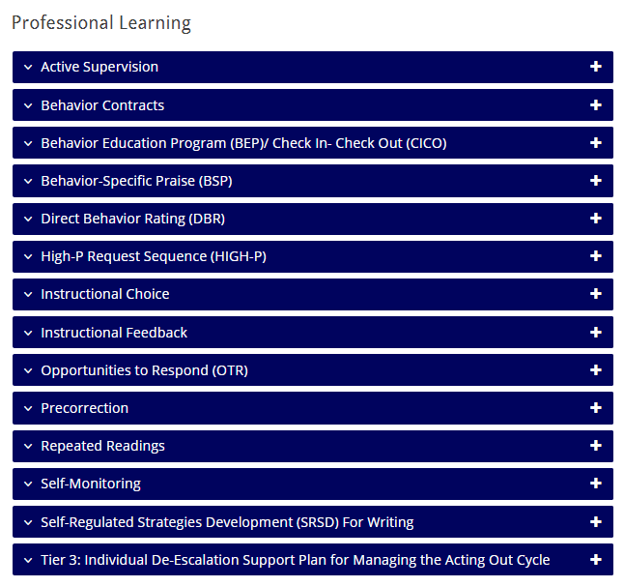
https://www.ci3t.org/pl
https://www.ci3t.org/literature
Click here to access the precorrection article
Notes:
Information about precorrection can be found on our professional learning tab in the blue accordion OR on the literature tab where you will find links to practitioner friendly books and free-access articles.

Slide 30
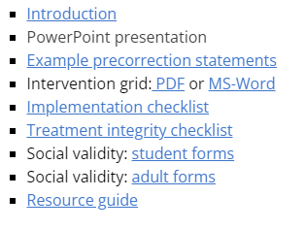
Precorrection
https://www.ci3t.org/pl
Notes:
This slide is a prompt for the presenter to pause, navigate to the website, download the precorrection PowerPoint, and use that to present for 15 minutes (see pacing guide)

Slide 31
Talk Time
https://www.ci3t.org/pl
Choose a breakout room based on your role:
I will implement precorrection with students
I will train others to implement precorrection with their students
Notes:
15-min timer
Breakout room(s) for practitioners focuses on - how might you incorporate precorrection in your classroom? Emphasize module materials for implementation (implementation checklist, TI/SV)
Breakout room(s) for trainers focuses on - how might you share this strategy with others? Emphasize module materials for training (e.g., tiered library PowerPoint, interactions, videos)

Slide 32
Strategy 2: Active Supervision

Slide 33
https://www.ci3t.org/pl
https://www.ci3t.org/literature
Click here to access the active supervision article
Notes:
Information about active supervision can be found on our professional learning tab in the blue accordion OR on the literature tab where you will find links to practitioner friendly books and free-access articles.

Slide 34
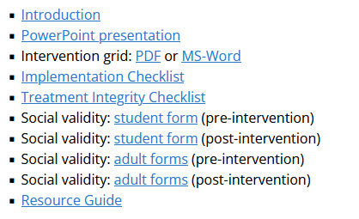
Active Supervision
https://www.ci3t.org/pl
Notes:
This slide is a prompt for the presenter to pause, navigate to the website, download the active supervision PowerPoint, and use that to present for 10 minutes (see pacing guide)

Slide 35
Talk Time
https://www.ci3t.org/pl
Choose a breakout room based on your role:
I will implement active supervision with students
I will train others to implement active supervision with their students
Notes:
15-min timer
Breakout room(s) for practitioners focuses on - how might you incorporate active supervision in your classroom? Emphasize module materials for implementation (implementation checklist, TI/SV)
Breakout room(s) for trainers focuses on - how might you share this strategy with others? Emphasize module materials for training (e.g., tiered library PowerPoint, interactions, videos)

Slide 36
Strategy 3: Opportunities to Respond

Slide 37
https://www.ci3t.org/pl
https://www.ci3t.org/literature
Notes:
Information about opportunities to respond can be found on our professional learning tab in the blue accordion OR on the literature tab where you will find links to practitioner friendly books outlining the steps to implementation.

Slide 38
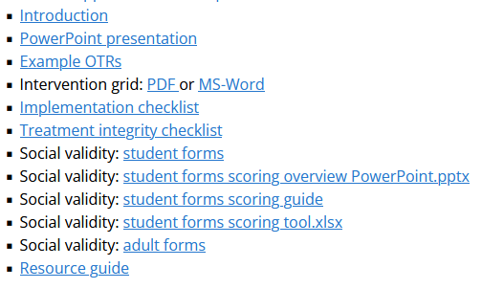
Opportunities to Respond
https://www.ci3t.org/pl
Notes:
This slide is a prompt for the presenter to pause, navigate to the website, download the opportunities to respond PowerPoint, and use that to present for 15 minutes (see pacing guide)

Slide 39
Talk Time
https://www.ci3t.org/pl
Choose a breakout room based on your role:
I will implement opportunities to respond with students
I will train others to implement opportunities to respond with their students
Notes:
15-min timer
Breakout room(s) for practitioners focuses on - how might you incorporate OTR in your classroom? Emphasize module materials for implementation (implementation checklist, TI/SV)
Breakout room(s) for trainers focuses on - how might you share this strategy with others? Emphasize module materials for training (e.g., tiered library PowerPoint, interactions, videos)

Slide 40
Exploring Other Teacher-Delivered, Low-Intensity Strategies in Ci3T Models

Slide 41
Integrated Lesson Planning

Slide 42
https://www.ci3t.org/pl
https://www.ci3t.org/literature

Slide 43
Low-Intensity Strategies for Academics and Behavior
Opportunities to Respond
What is one additional strategy you would like to explore?
What do you think about:
Sharing a 10-minute strategy tip in a faculty and staff meeting
Discussing in your professional learning community
Organizing a book or article study?
Developing onsite coaches?
Behavior-Specific Praise
Active Supervision
Instructional Feedback
High p Requests
Precorrection
Instructional Choice

Slide 44
Wrapping Up and Moving Forward

Slide 45
Project EMPOWER - Traditional
Ci3T EMPOWER Sessions Location: Remote via Zoom Attended by: School Ci3T Leadership Teams, Ci3T District Trainers and Coaches, Faculty and Staff, Families (adults only). Community Members |  | Times (Pacific) | Times (Central) | Times (Eastern)
1. Getting Started | Sep. 19, 2023 (Tu) | 3:00 – 5:00 p.m. | 5:00 – 7:00 p.m. | 6:00 – 8:00 p.m.
2. Screening | Oct. 19, 2023 (Th) | 3:00 – 5:00 p.m. | 5:00 – 7:00 p.m. | 6:00 – 8:00 p.m.
3. Low Intensity Strategies | Nov. 30, 2023 (Th) | 3:00 – 5:00 p.m. | 5:00 – 7:00 p.m. | 6:00 – 8:00 p.m.
4. Tier 2 | Jan. 9, 2024 (Tu) | 3:00 – 5:00 p.m. | 5:00 – 7:00 p.m. | 6:00 – 8:00 p.m.
5. Tier 3 | Mar. 28, 2024 (Th) | 3:00 – 5:00 p.m. | 5:00 – 7:00 p.m. | 6:00 – 8:00 p.m.
6. Moving Forward | Apr. 23, 2024 (Tu) | 3:00 – 5:00 p.m. | 5:00 – 7:00 p.m. | 6:00 – 8:00 p.m.

Slide 46
Ci3T
Comprehensive Professional Learning Plan
Ci3T: Primary Prevention
Session 1:
Overview of Ci3T Prevention Models
Setting a Purpose
Establish team meetings and roles
Session 2:
Mission and Purpose
Establish Roles and Responsibilities
Procedures for Teaching
Procedures for Reinforcing
Reactive Plan
Session 3:
Procedures for Monitoring
Session 4:
Revise Primary Plan using Stakeholder feedback
Prepare presentation
Ci3T: Secondary Prevention
Session 5:
Overview of Teacher focused Strategies
Overview of Student Focused Strategies
Using data to determine which students may need Secondary (Tier 2) supports
Draft the Secondary Intervention Grid based on existing supports
Ci3T: Tertiary Prevention
Session 6:
Final revisions of Ci3T Plan based on stakeholder feedback
Draft Tertiary (Tier 3) Prevention Intervention Grids
Design Implementation Manual and Plan for roll out to faculty, students, and parents
Ci3T Leadership Team Training Sequence
Implementation Stages of Tier 2 and 3 within Ci3T
Additional Professional Development on Specific Topics
Core Content Curriculum
Check In - Check Out
Functional Assessment-based Interventions
Reading, Math, Writing Benchmarking and Progress Monitoring Tools
Interventions, Strategies, & Practices
Additional Tier 3 Supports
Instructional Techniques to Improve Students’ Motivation; Classroom Management Practices;
Low-Intensity Behavior Supports

Slide 47
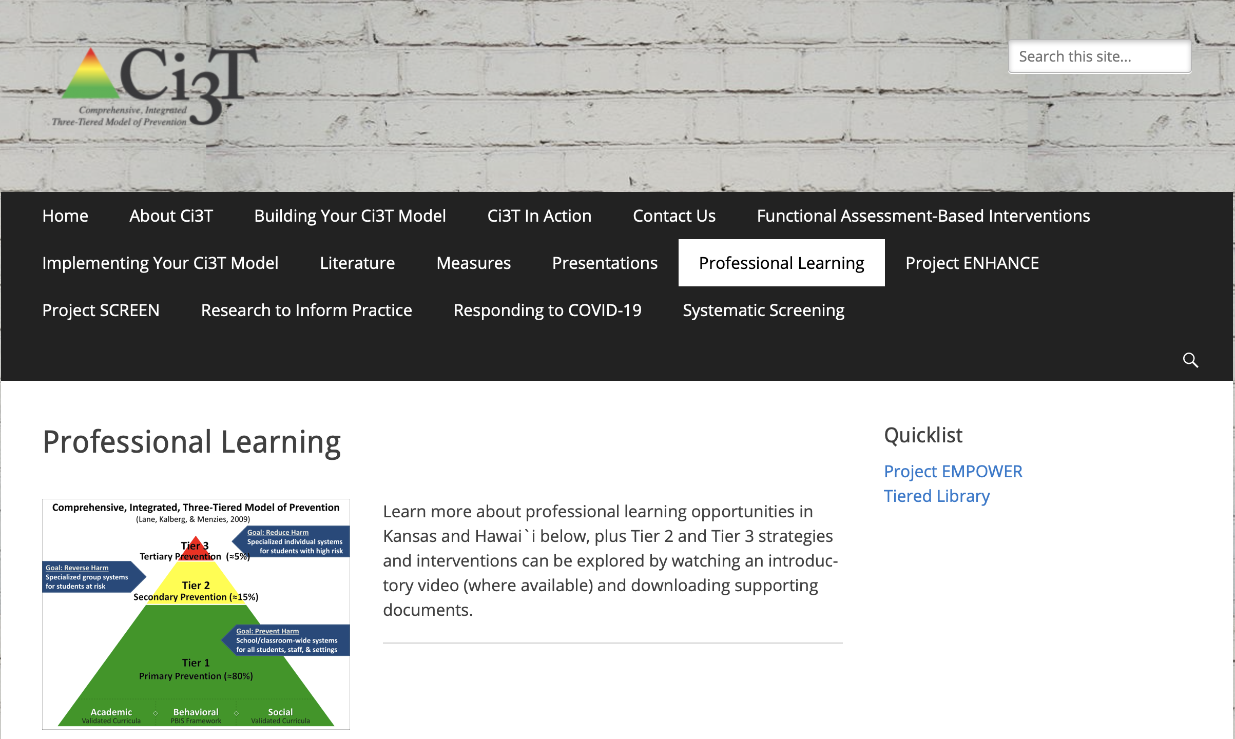
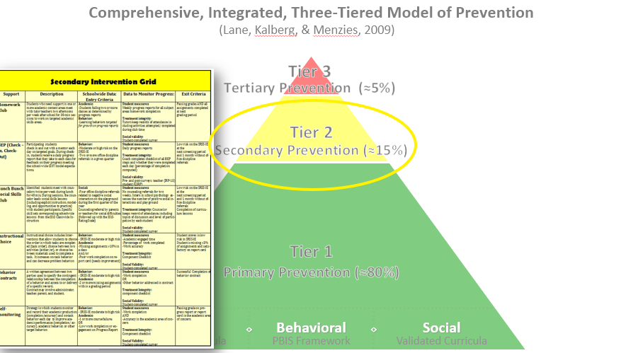
Tiered Intervention Library

Slide 48
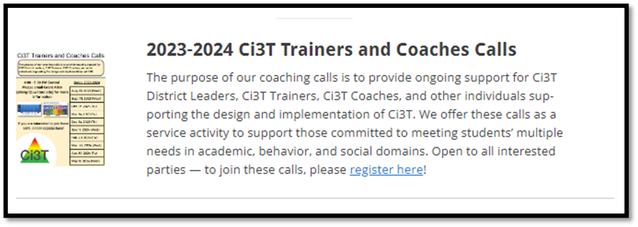
Ci3T Trainer and Coaches Calls

Slide 49
Ci3T Professional Learning Calendar
 | July | Aug | Sep | Oct | Nov | Dec | Jan | Feb | Mar | Apr | May | Jun
Ci3T Training |  |  |  |  | Ci3T Professional Learning Series Session 1 | Ci3T Professional Learning Series Session 2 | Ci3T Professional Learning Series Session 3 | Ci3T Professional Learning Series Session 4 |  | Ci3T Professional Learning Series Session 5 | Ci3T Professional Learning Series Session 6
Ci3T Implementation Support | Ci3T Implementation Series Prep Session |  | Ci3T Implementation Series Session 1 |  | Ci3T Implementation Series Session 2 |  | Ci3T Implementation Series Session 3 |  | Ci3T Implementation Series Session 4 | Ci3T Implementation Series Session 5
Ci3T EMPOWER |  |  | Ci3T EMPOWER Session 1 | Ci3T EMPOWER Session 2 | Ci3T EMPOWER Session 3 |  | Ci3T EMPOWER Session 4 |  | Ci3T EMPOWER Session 5 | Ci3T EMPOWER Session 6
Ci3T Trainers & Coaches Calls |  | Trainers & Coaches Call Session 1 | Trainers & Coaches Call Session 2 | Trainers & Coaches Call Session 3 | Trainers & Coaches Call Session 4 | Trainers & Coaches Call Session 5 | Trainers & Coaches Call Session 6 | Trainers & Coaches Call Session 7 | Trainers & Coaches Call Session 8 | Trainers & Coaches Call Session 9 | Trainers & Coaches Call Session 10

Slide 50
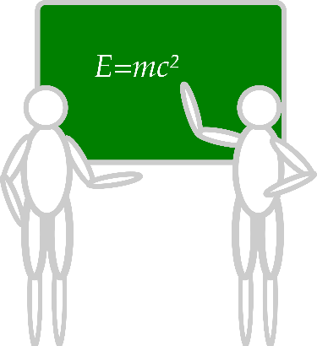
Sustaining and Disseminating Professional Learning
Designate two staff to attend trainings to become on-site coaches
10 min @ next Faculty and Staff meeting
Setting Up for Success with Ci3T
Systematic Screening
Low-Intensity Strategies
Tier 2
Planning Ahead
Tier 3

Slide 51
Accessing Project EMPOWER Professional Learning

Slide 52
Wrapping Up & Previewing Next Session
Today
Next time
Overview of Teacher-Delivered, Low-Intensity Strategies in Ci3T Models
Strategy 1: Precorrection
Strategy 2: Active Supervision
Strategy 3: Opportunities to Respond
Exploring Other Teacher-Delivered, Low-Intensity Strategies in Ci3T Models
Overview of Secondary (Tier 2) Interventions in Ci3T Models: Data-informed Decision-making
Intervention 1: Behavior Contracts as a Tier 2 Intervention
Intervention 2: Self-Regulated Strategy Development (SRSD) for Writing as a Tier 2 Intervention
Exploring Other Secondary (Tier 2) Interventions in Ci3T Models

Slide 53
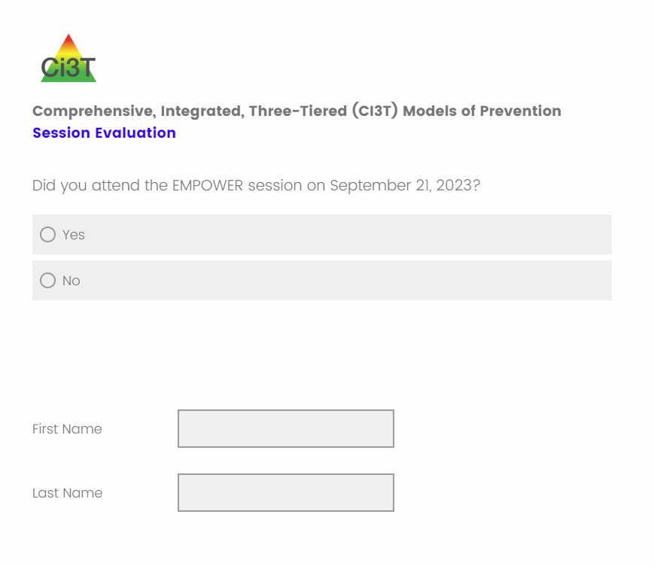
Comprehensive, Integrated, Three-Tiered Model of Prevention
(Lane, Kalberg, & Menzies, 2009)
Thank you!
Notes:
Tag us in your Ci3T highlights- we’d love to see Ci3T in action! Follow us on Twitter or Instagram for updates and links to resources! @Ci3TModel
You will receive a brief session evaluation – we value your feedback and would greatly appreciate you taking a few minutes to share your thoughts on what you liked about the session and how we can improve

